Slide 1




ARTBASE DBMS FINAL PROJECT
SRIDEVI ANANDAN

Slide 2
Agenda
Introduction
ER DIAGRAM
Project Explanition
Queries and tables
Conclusion

Slide 3
Introduction
Art galleries, the primary users of the product, maintain comprehensive data, detailing artists with unique names, birthplaces, age, and distinct artistic styles. Each artwork is meticulously recorded, noting the artist, creation year, unique title, art type, and price. To organize the collection, artworks are categorized into various groups, allowing for flexible classifications. Customers, regarded as valuable enthusiasts, have their information stored with unique identifiers like name and address, alongside crucial transactional data such as the total amount spent. The system also tracks customer preferences, providing galleries valuable insights into patrons' artistic tastes.
3

Slide 4
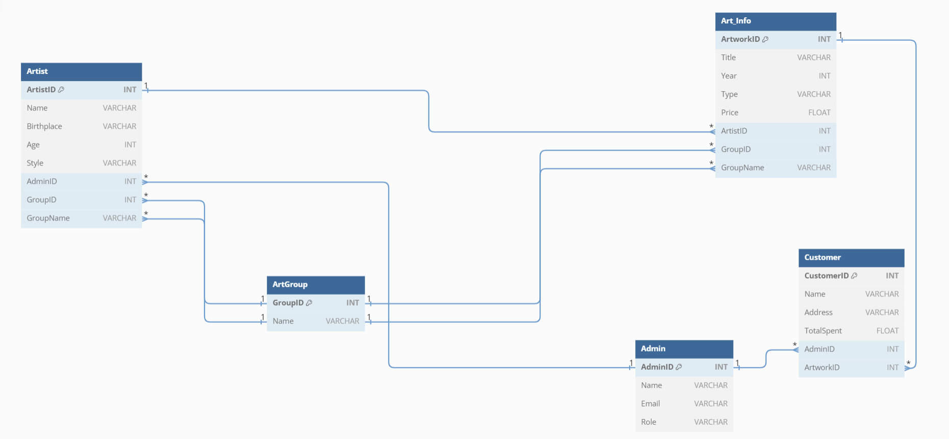
ER DIAGRAM

Slide 5
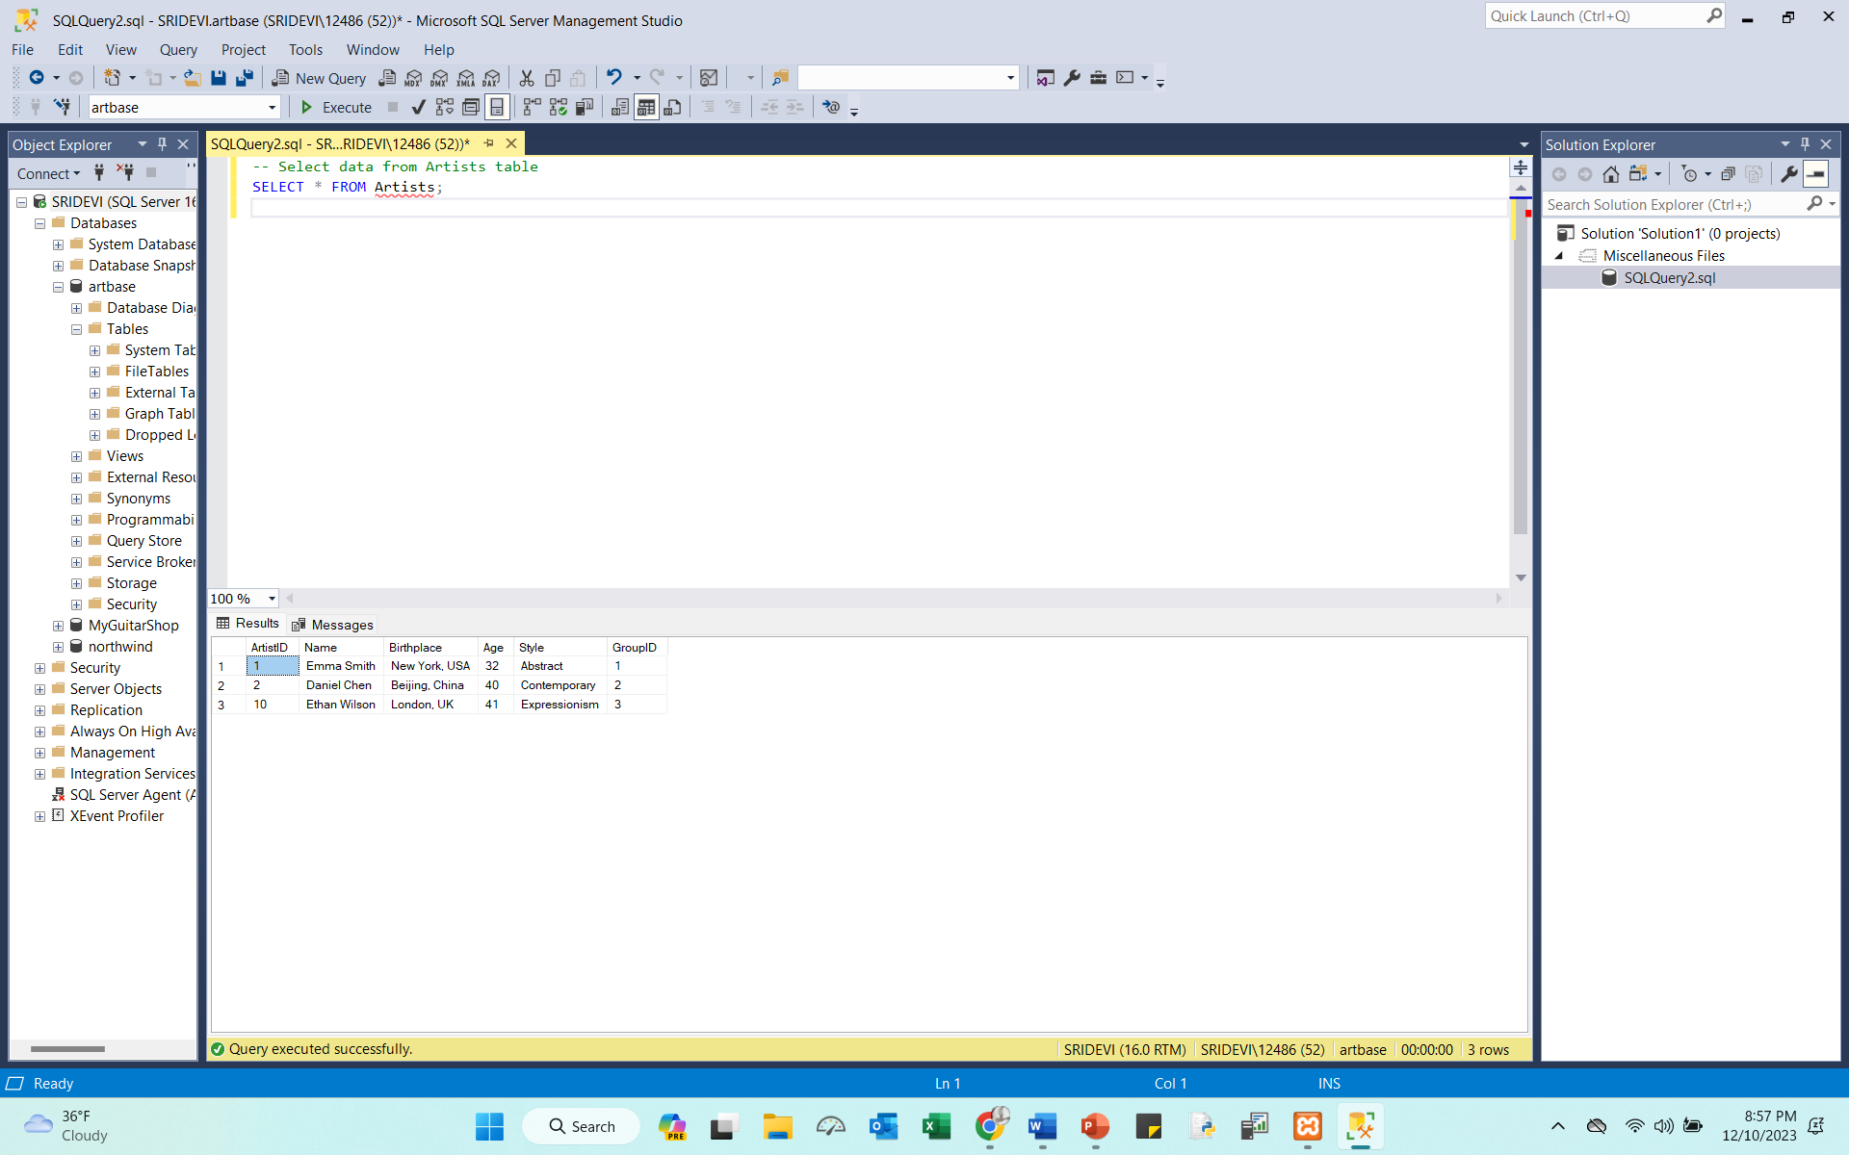
ARTIST
Query : CREATE TABLE Artists (
ArtistID INT PRIMARY KEY,
Name VARCHAR(255),
Birthplace VARCHAR(255),
Age INT,
Style VARCHAR(255),
GroupID INT FOREIGN KEY REFERENCES Groups(GroupID)
);
INSERT INTO Artists (ArtistID, Name, Birthplace, Age, Style, GroupID)
VALUES
(1, 'Emma Smith', 'New York, USA', 32, 'Abstract', 1),
(2, 'Daniel Chen', 'Beijing, China', 40, 'Contemporary', 2),
(10, 'Ethan Wilson', 'London, UK', 41, 'Expressionism', 3);

Slide 6
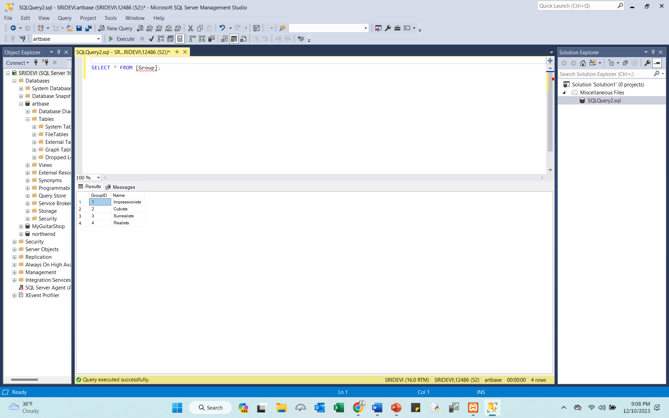
ARTGROUP:
Query :CREATE TABLE [Group] (
GroupID INT PRIMARY KEY,
Name VARCHAR(255)
);
INSERT INTO [Group] (GroupID, Name)
VALUES
(1, 'Impressionists'),
(2, 'Cubists'),
(3, 'Surrealists'),
(4, 'Realists');
SELECT * FROM [Group];

Slide 7
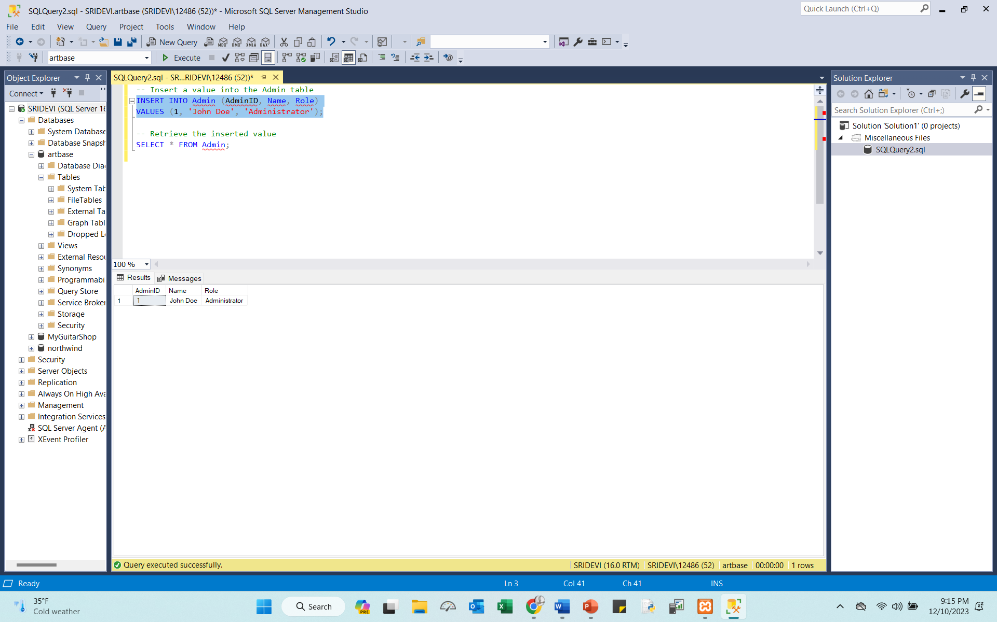
ADMIN:
Query :CREATE TABLE Admin (
AdminID INT PRIMARY KEY,
Name VARCHAR(255),
Role VARCHAR(255)
);
INSERT INTO Admin (AdminID, Name, Role)
VALUES (1, 'John Doe', 'Administrator');

Slide 8
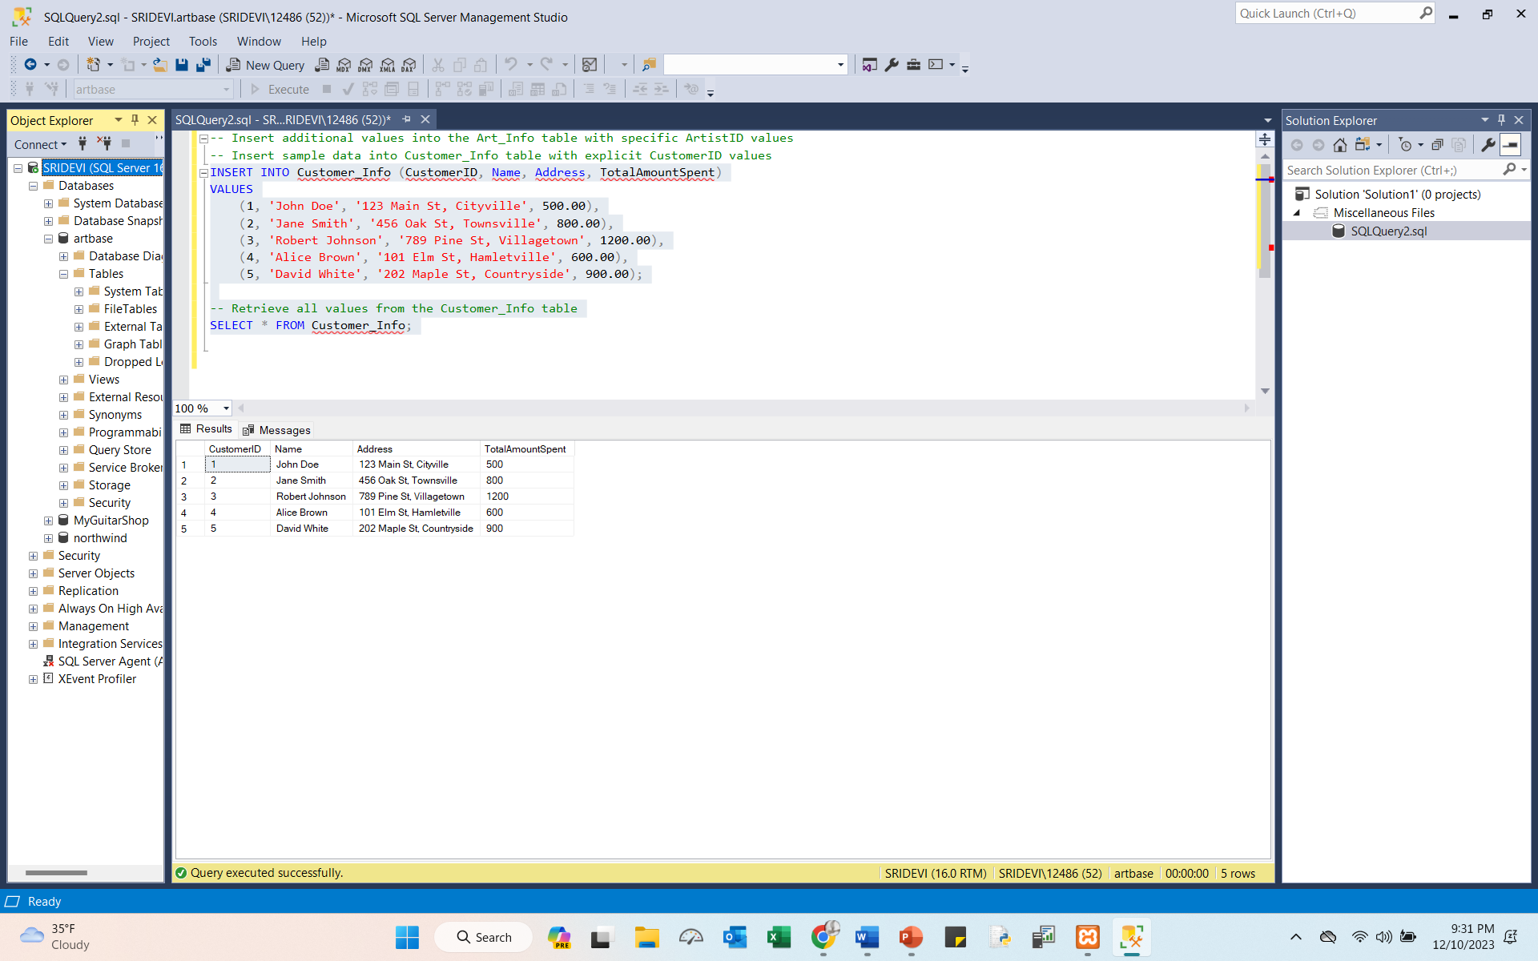
. CUSTOMER_INFO:
QUERY: CREATE TABLE Customer_Info (
CustomerID INT PRIMARY KEY,
Name VARCHAR(255),
Address VARCHAR(255),
TotalAmountSpent FLOAT);
INSERT INTO Customer_Info (CustomerID, Name, Address, TotalAmountSpent)
VALUES
(1, 'John Doe', '123 Main St, Cityville', 500.00),
(2, 'Jane Smith', '456 Oak St, Townsville', 800.00),
(3, 'Robert Johnson', '789 Pine St, Villagetown', 1200.00),
(4, 'Alice Brown', '101 Elm St, Hamletville', 600.00),
(5, 'David White', '202 Maple St, Countryside', 900.00);
SELECT * FROM Customer_Info;

Slide 9
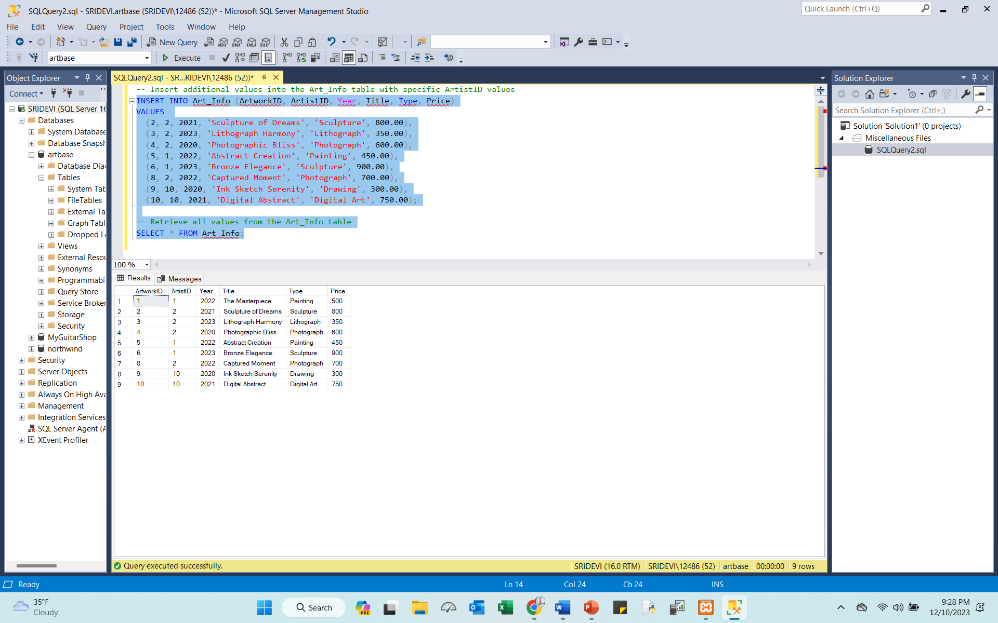
ART_INFO:
QUERY:CREATE TABLE Art_Info (
ArtworkID INT PRIMARY KEY,
ArtistID INT FOREIGN KEY REFERENCES Artists(ArtistID),
Year INT,
Title VARCHAR(255),
Type VARCHAR(255),
Price FLOAT
);
INSERT INTO Art_Info (ArtworkID, ArtistID, Year, Title, Type, Price)
VALUES
(2, 2, 2021, 'Sculpture of Dreams', 'Sculpture', 800.00),
(3, 2, 2023, 'Lithograph Harmony', 'Lithograph', 350.00),
(4, 2, 2020, 'Photographic Bliss', 'Photograph', 600.00),
(5, 1, 2022, 'Abstract Creation', 'Painting', 450.00),
(6, 1, 2023, 'Bronze Elegance', 'Sculpture', 900.00),
(8, 2, 2022, 'Captured Moment', 'Photograph', 700.00),
(9, 10, 2020, 'Ink Sketch Serenity', 'Drawing', 300.00),
(10, 10, 2021, 'Digital Abstract', 'Digital Art', 750.00);
SELECT * FROM Art_Info;

Slide 10
CONCLUSION
ArtBase is a robust and flexible database system designed specifically for art gallery management. Its well-organized structure and efficient handling of relationships ensure reliable data management and scalability. The system's adaptability allows art galleries to effectively curate artists, categorize artworks, and engage with customers.
ArtBase serves as a valuable tool, providing not only data organization but also meaningful insights for informed decision-making, contributing to the overall success of art galleries in the ever-evolving art industry.

Slide 11
Thank You
Let’s get into execution part

